Slide 1
Analyzing the
Boston Crime
Dataset
December 5th, 2019
Alexander Moore Reetayan Das Abubeker Abdullahi

Slide 2
The Data
Crime Dataset provided by Boston Police Department(BPD) documented initial details surrounding an incident to which an officer responded.This is a dataset containing records from the new crime incident report system, which includes a reduced set of fields focused on capturing the type of incident as well as when and where it occurred.
Source
Kaggle (https://www.kaggle.com/AnalyzeBoston/crimes-in-boston)
Range
June 14th, 2015 to September 3rd, 2018

Slide 3
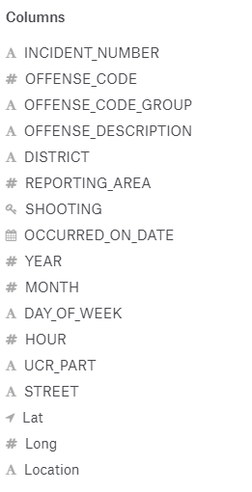
Dataset Description
Influences :
[1]Which Crime is mostly likely or could be occurred?
[2] Which Time is most crucial for a crime to be occurred ?
[3] What Areas of Boston Could be impacted?
[4] What are the factors which could affect the different type of Crime?

Slide 4
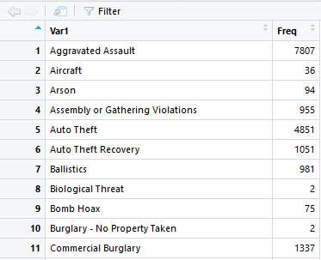
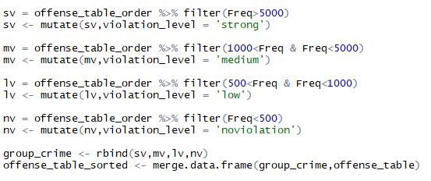
Data Preprocessing-1

Slide 5
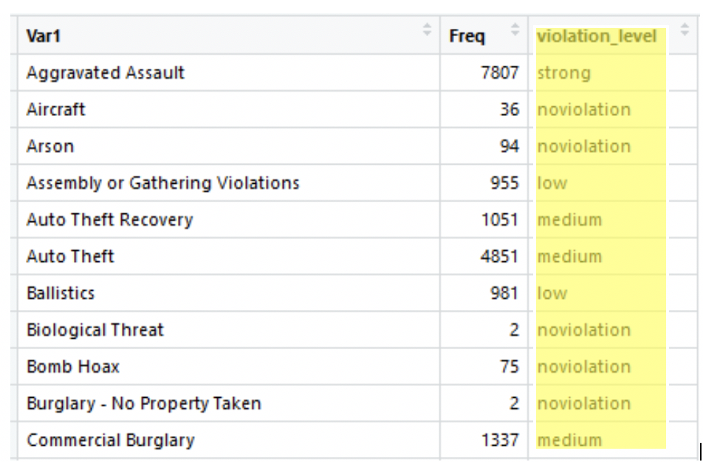
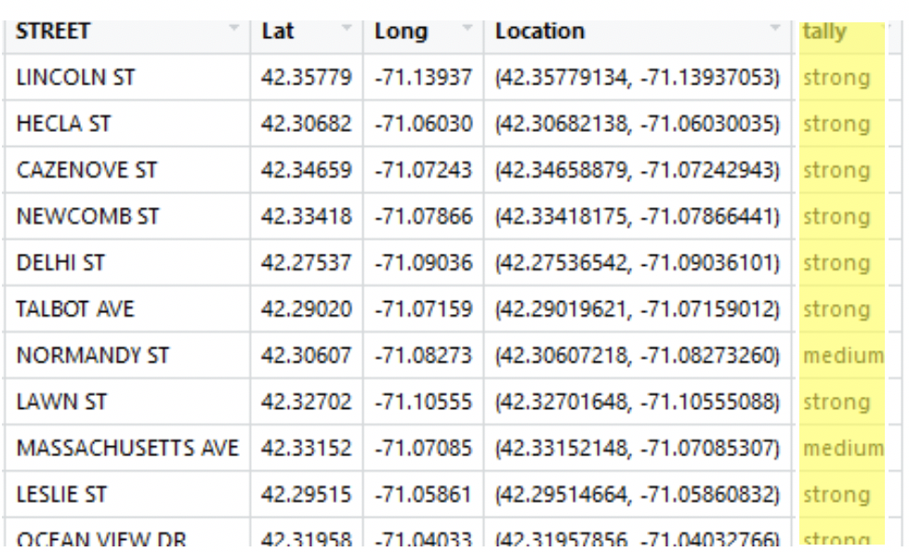
Data Preprocessing- 2

Slide 6
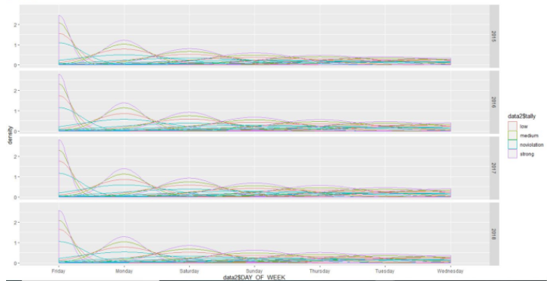
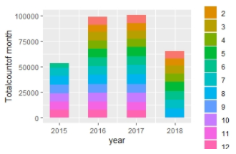
Primary/Trend Analysis
Average Distribution of Crime over 4 Years on respective Months
Crime Intensity Graph over number of Days on 4 years
Friday has the highest occurrence of the strong violation crime

Slide 7
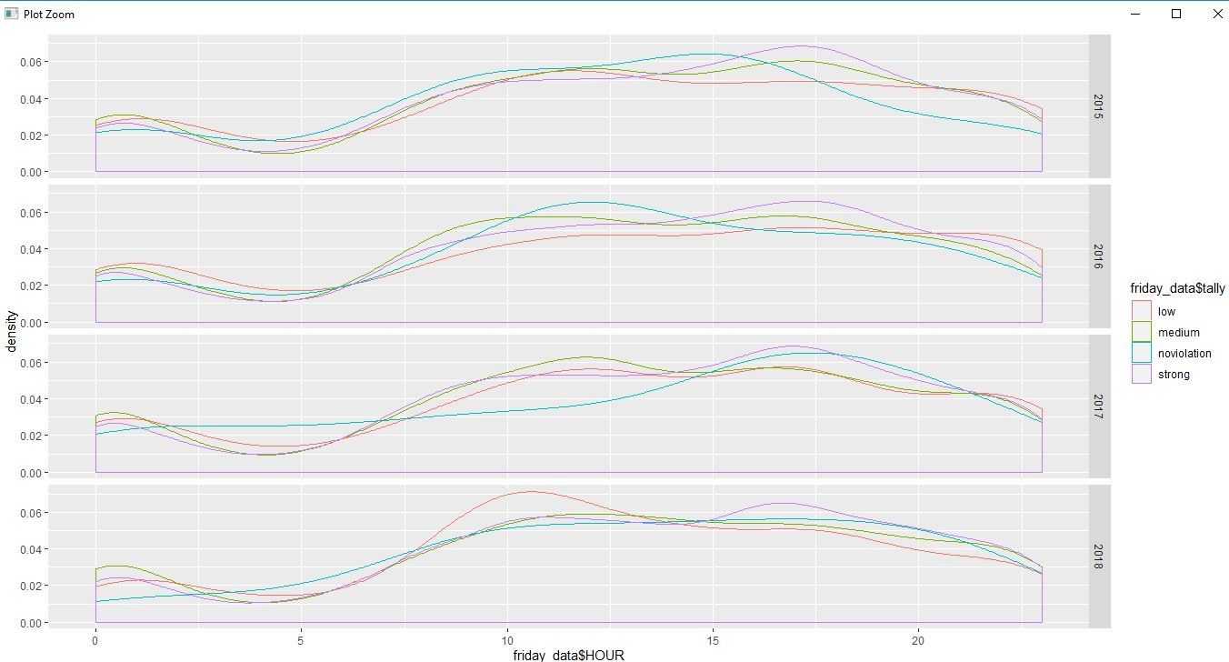
Analyses
We have separated the Friday Data and wanted to see which time in the Friday has the most occurrence of strong level of violation here.
Graph shows that in 4 years every week of Friday in 17:30( Late afternoon) has the highest occurrence of strong violation

Slide 8
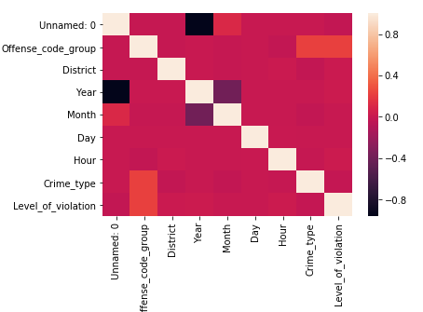
Selection of Predictors for the Decision Tree Model
Correlation matrix shows that
“Offense Code Group”, “District”,
“Crime-type” has the high correlation value.
So we choose them as our predictors.

Slide 9
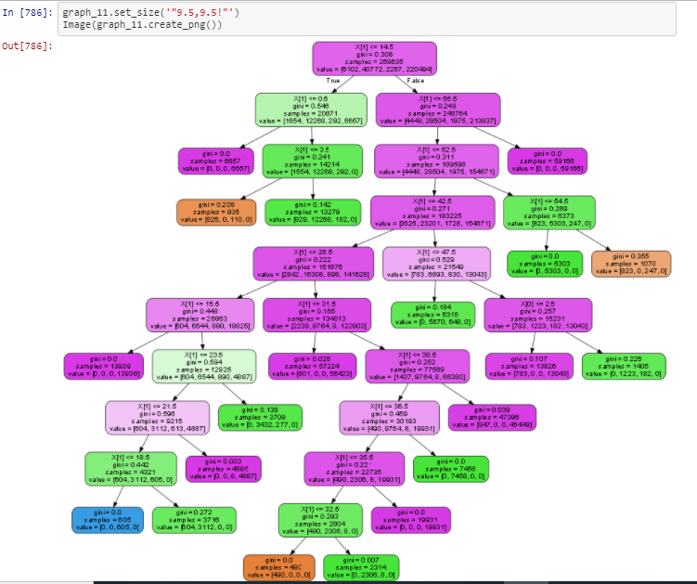

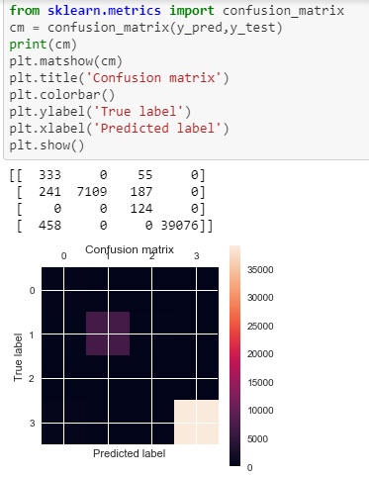
Prediction Model 1
Predictors : Crime_type, Offense_code_group District ;Label = “Level_of_violation”
Note : District and Offense Code had to be encoded to 0 and 1 as they were not in numeric Types

Slide 10
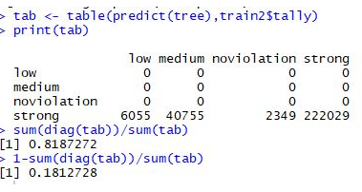
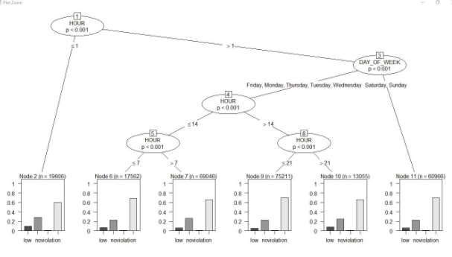
Separating WeekDays Vs Weekends Crime
This Decision tree tells about that a strong separation rule for weeknd crime and weekdays Crime.
Although Friday Data holds the most strong level violation it belongs to the weekdays Rule.
Prediction Model 2

Slide 11
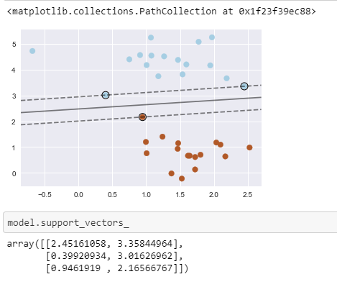
Feature Clustering - District
We took the “District” Feature which have a high Feature importance and objective was to cluster them at least in two groups based on the level of violation(label = [1 to 5])
Applied Support Vector machine to find the
Widest street between two clusters

Slide 12
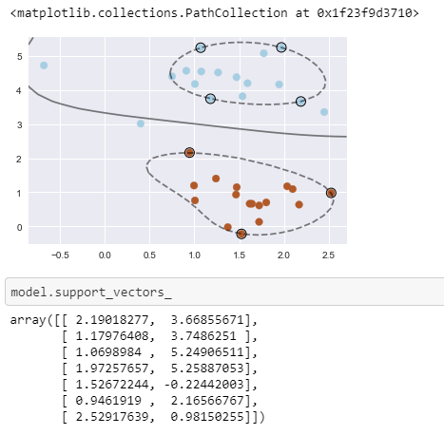
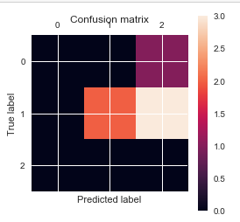
Feature Clustering - Offense codes
Linearity didn't exist when we introduced the “Offense code” as Feature.
Applied RBF kernel to plot the Decision Boundary here.

Slide 13
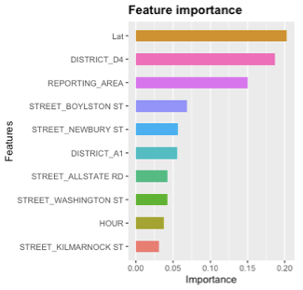
Analysis of Larceny Occurrences
Larceny was found to be the most common crime within the dataset.
Predictions of Larceny as a binary outcome with XGBoost
Objective - Binary-Logistic
Booster - Decision Trees
Model Accuracy - R² = 91.6%
Feature importance
Spatial features were more important than temporal features

Slide 14
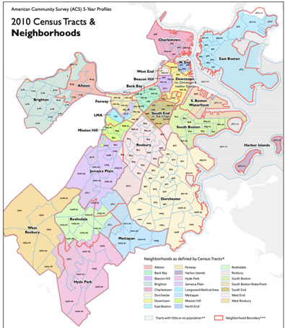
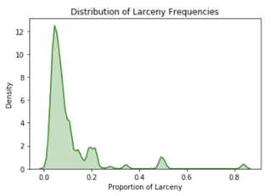
Analysis of Larceny Using Census Data
Why were certain areas more prone to theft than others?
Merging SES data with Crime data
Location Data was used to make requests for corresponding tracts with the Census API
Census Tracts for coordinates recorded, joined with Crime Report dataset
SES Data from 2015 ACS merged by Tract Number

Slide 15
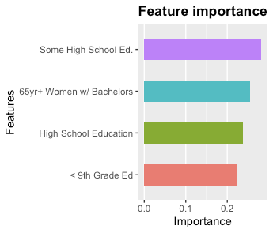
Analysis with Census Data
Tract level compositional differences for analyses -
Age, Gender, Race, and Educational Attainment
After One-Hot Encoding (p = 729)
Model Accuracy - R² = 91.07%
Educational Attainment appears most related with differences in frequency of theft across neighborhoods

Slide 16
Conclusion
Data Collection and Preprocessing -
Calculating the violation tally based on the frequency of the offense code groups have helped us classify the different types of crimes as non-violation, low, medium and high and opened room for further analysis.
Primary Analyses -
Friday Has the most occurrence of strong level of violation at 17:30 pm.
Even though Friday Has the most occurrence of strong level of violation it belongs to the weekDay crime Decision Rule which has a occurrence of crime in time < 14:00 hours.
Explanation of Predictions -
Educational Attainment is highly related with the frequency of Larceny Occurrences
Further research must be conducted to understand true causal path of relationship

